Slide 1
UNIVERSITY OF BUEA
FACULTY OF ENGINEERING AND TECHNOLOGY
CEF 440: INTERNET PROGRAMMING AND INTERNET PROGRAMMING TASK 2
REQUIREMENT GATHERING
PRESENTED BY
AHOUMO TEMATEU ROXANE
DERRICK FORCHA
BOUCHUKE DANIEL
TIANI PEKINS EBIKA
SUPERVISED BY
SAMUEL OSHO
DR. NKEMENI VALERY
⦁ [1]

Slide 2

TABLE OF CONTENTS
INTRODUCTION
REQUIREMENT GATHERING
REQUIREMENT GATHERING TECHNIQUES
ANALYZING AND DOCUMENTATION OF GATHERED REQUIREMENTS
CONCLUSION
⦁ [2]

Slide 3

1. INTRODUCTION
The evolution of mobile computations and wireless communications technologies has embedded itself in our lives due to its rapid development. One such application is the lost and found items retrieval utility. The loss or misplacement of personal belongings is a common occurrence that can cause inconvenience and distress to individuals. Traditional methods of searching for missing objects, such as posting flyers or contacting lost and found services, are often time-consuming and ineffective. To address this issue, this project proposes the development of a Mobile-Based Archival and Retrieval of Missing Objects Application using Image Matching.
⦁ [3]

Slide 4
2. REQUIREMENT GATHERING
Requrements gathering (or requirements elicitation) involves defining stakeholders' specific needs and expectations for a new system, software application, or any other project.In our archival and retrieval of missing objects, the requirements gathering process has four main parts.
01
⦁ Identify the stakeholders
02
⦁ Collect information
03
⦁ Document requirements
04
⦁ Solution requirements
⦁ [4]

Slide 5
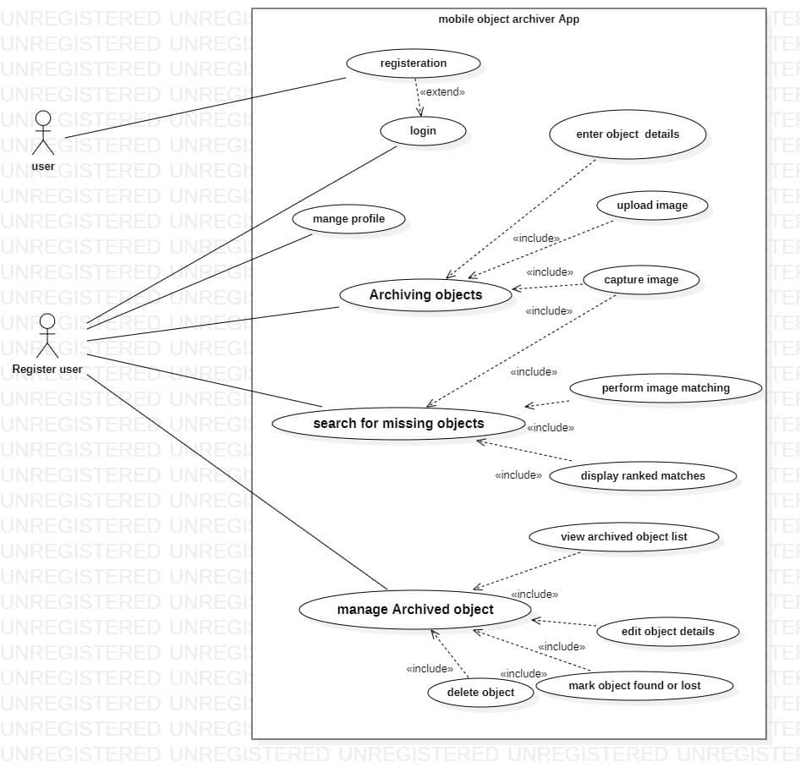
Below is a representaion of a use case diagram used for our lost and found document software
⦁ [5]

Slide 6
A. Functional requirements
Are product features or functions that developers must implement to enable users to accomplish their tasks. So it’s essential to make them clear both for the development team and the stakeholders.
⦁ User Management:
Register and account creations
Authentication
⦁ Object archival
Users can capture images and add details of objects using the device camera and gallery
⦁ Object Retrieval:
Users can search for missing objects using a new image captured by the camera.
⦁ [6]

Slide 7
B. Non-functional requirements
IAre not related to the system's functionality but rather define how the system should perform. They are crucial for ensuring the system's often influencing the overall experience. These non functional requirements include
⦁ Performance:
⦁ Availability:
⦁ Usability:
⦁ Security:
⦁ [7]

Slide 8
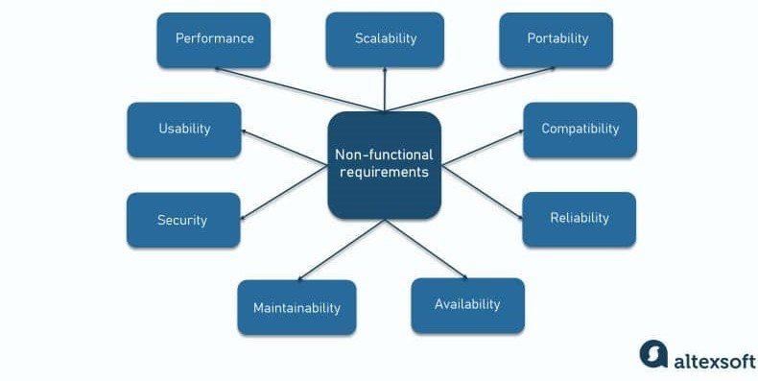
elow is a representaion of a the non functional requirements used for our lost and found document software

Slide 9
3. REQUIREMENT GATHERING TECHNIQUES
Home
Service
These are simply the various ways and methods used to have as much as requirements from the users. There are two types of UX reserch, namely; Quantitative and Qualitative research.
A. Quantitative Research
In short, it means collecting and analyzing numerical data to describe characteristics, find corrections ; or test hypotheses. . Below are some of the techniques used to carry out Quantitative Research.
⦁ Survey
A survey is a method of gathering information using relevant questions from a sample of people with the aim of understanding population as a whole. Also, there are two types of survey; Online Survey and Onsite Survey
⦁ [8]

Slide 10
⦁ Requirement workshop
Generally, researchers will ask participants to attempt a series of assigned tasks, and then observe and record how well they can accomplish those tasks. After the test is done, you’ll gather and analyze data, and then make choices about the best next-steps.
⦁ Prototyping
Prototyping is a newer technique used in requirement gathering. You create a prototype based on initial gathering results, like brainstorming or group interviews, to show a client an early version of a workable solution.
⦁ [9]

Slide 11
B. Quantitative Research
Quantitative analysis is a process of naturalistic inquiry that seeks an in-depth understanding of social phenomena within their natural setting. Six common types of qualitative research are phenomenological, ethnographic, grounded theory, historical, case study, and action research.
⦁ Ethnographic Research
Ethnographic research is an approach to data collection and analysis that aims at evaluating and categorizing human experiences through the lens of the participants’ cultural and ethnic backgrounds. Ethnographic research can be further divided into
⦁ Passive Observation
⦁ Contextual Interviews
⦁ Archival Research
⦁ [10]

Slide 12
⦁ Phenomenological Research
Phenomenological studies, for their part, place major emphasis on the unique experiences of individuals. Phenomenological research focuses primarily on discovering personal thoughts and experience.
⦁ Document Analysis
Document analysis includes reviewing the existing system's documentation, like user manuals and instructions. It is helpful particularly for any changeover risk mitigation and you can glean important information that pushes the boundary of establishing new requirements or validating existing ones.
⦁ [11]

Slide 13
4. ANALYZING AND DOCUMENTATION OF GATHERED REQUIREMENTS
⦁ Document Requirements
-Requirements documents of any kind influence the analysis, design, implementation, and test phases directly and indirectly.
-Requirements documents may also support the change management activities.
-Documenting the requirements can help to quickly overcome legal conflicts between two or more parties.
⦁ [13]

Slide 14
Confirming understanding of requirements
⦁ USECASE DIAGRAM:
A usecase diagram is a UML Diagram which help us to organise all the functional requirement of an app after collecting the various reauirements from users.
⦁ BUILD A PROTOTYPE
A prototype is the first preliminary output of a porject. You can do a prototype after the collection of data and present it to the various stakeholders for feedback.
⦁ [14]

Slide 15
5. CONCLUSION
The requirement gathering phase plays a pivotal role in mobile app development as it involves the systematic collection and documentation of crucial information that defines the app's purpose, desired functionality, user requirements, design preferences, and technical constraints. This phase serves as the foundation for the subsequent stages of analysis, design, implementation, and testing. By engaging stakeholders effectively and employing various techniques such as interviews, surveys, and workshops, the development team can gain valuable insights and ensure a comprehensive understanding of the project's objectives.
Data 01
Data 02
⦁ [16]

Slide 16
Thank You
⦁ [17]

